Slide 1
Project 3: Natural Language Processing w/ Reddit
By: Bryan Ho (DSI 14)

Slide 2
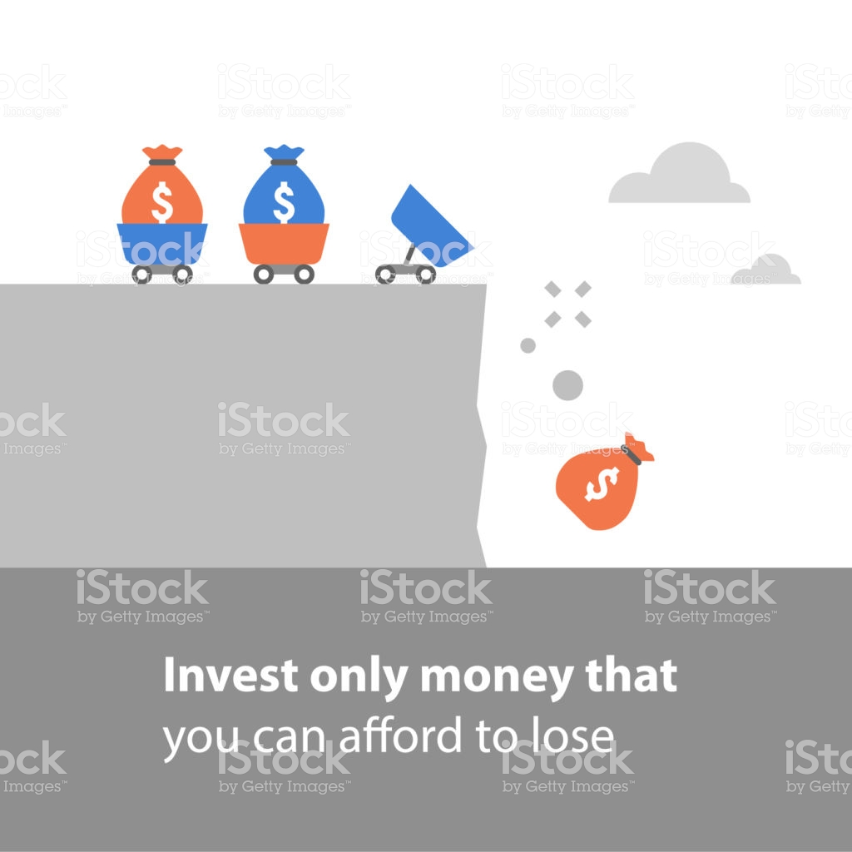
Problem Statement
How do we ensure people appropriately allocate their finances?

Slide 3
Datasets (Reddit API)
r/stocks
648K subscribers
840 unique posts
r/povertyfinance
306K subscribers
994 unique posts
Cleaning
Remove stopwords, digits, punctuations, emojis (With unicode)
Drop video and stickied posts
Lemmatize similar words

Slide 4
Exploratory Data Analysis
Unigram and Bigram top words

Slide 5
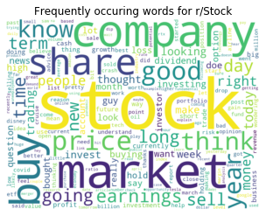
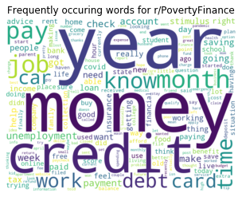
Unigram Words

Slide 6
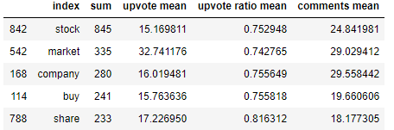
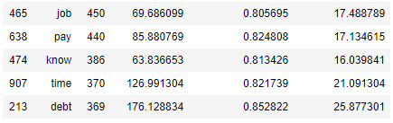
Unigram Words (Top 5)
r/stocks
r/povertyfinance

Slide 7
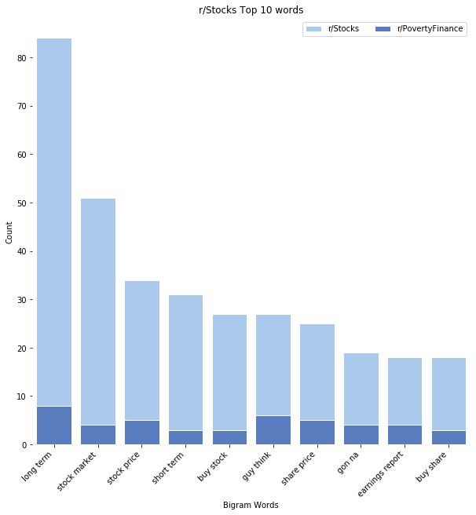
Bigram Words
r/stocks
Key Findings
Price
Short / Long-Term
Earnings

Slide 8
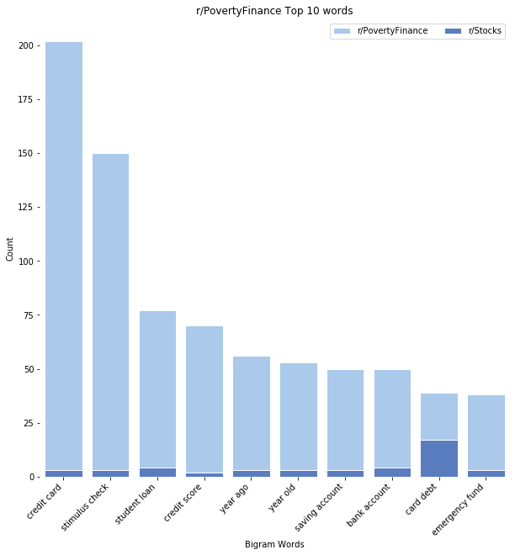
Bigram Words
r/povertyfinance
Key Findings
Debt
Timing
Stimulus

Slide 9
Model Fitting & Evaluation
Logistic Regression vs. Naive Bayes Multinomial
Notes:
Logsitic Regression for general classification and Naive Bayes for probability classification, multinomial due to each feature having multiple integers

Slide 10
GridSearch
Best Parameters
Max features: 2000, 250, 500, 1000
N_gram: (1,1), (1,2), (1,3)
Max_df: 0.9, 0.95
Min_df: 2, 3
Accuracy | Train | Test
Logistic Regression | 99% | 95% | Slightly overfit
Naive Bayes Multinomial | 98% | 96% | Ideal

Slide 11
Confusion Matrix
 |  | Actual Values
 |  | r/stocks | r/povertyfinance
Predicted Values | r/stocks | 269 | 11
 | r/povertyfinance | 8 | 316
Top Words
Account Money Security Deposit
Top Words
Month Looking Tip
Year
Think
Notes:
FN 8 FP 11 Precision and Recall are good

Slide 12
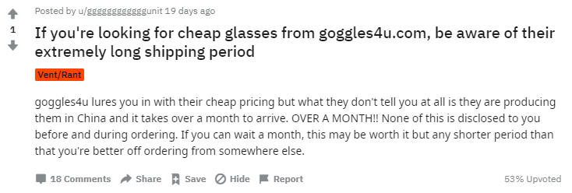
False Positive Analysis
Common words month, period and pricing
Predicted as r/stocks
Red circles indicate poor reception of post

Slide 13
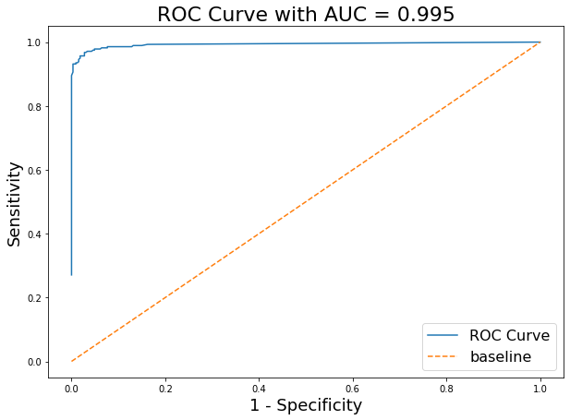
ROC AUC

Slide 14
Conclusion
How will this help people seeking financial advice?

Slide 15
Key Distinctions
Community | r/stocks | r/povertyfinance
Focus | Earnings and Stocks | Credit Card and Loans
Time-Frame | Long-term | Short-term
Net Asset State | Positive | Negative
Answer:
Proper finance allocation from proper advice, mitigates the impact of a recession

Slide 16
Recommendations for further studies
Expand ngram_words to investigate more than 3 (e.g. stock broker account for r/stocks vs. savings account for r/povertyfinance)
Test model on other finance subreddits (e.g. r/investing, r/cryptocurrency)
Include new stop words (Year and Month may be removed)
Improve lemmatizer to include internet slangs and financial terms

Slide 17
Limitations
Does not factor in emojis
Some posts have low upvotes so may have done an analysis on high upvotes
If only isolate high upvotes, potentially insufficient data to train our model

Slide 18
Thank you

